Slide 1
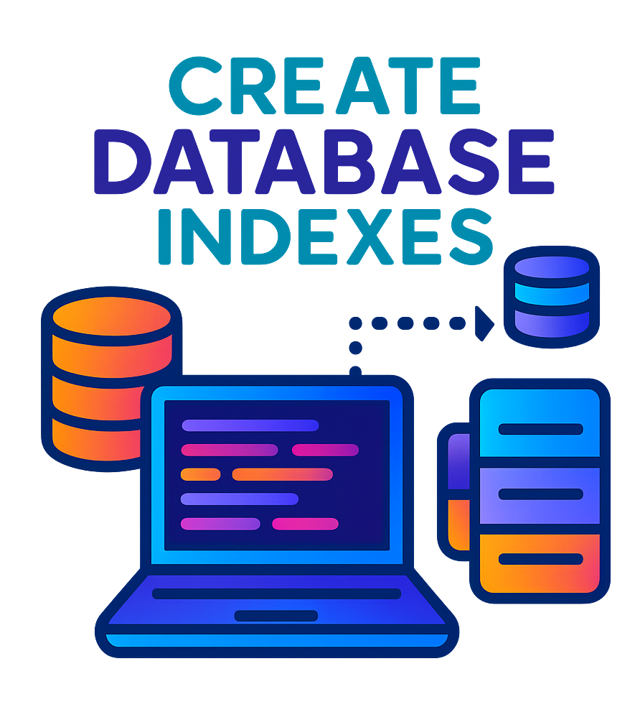
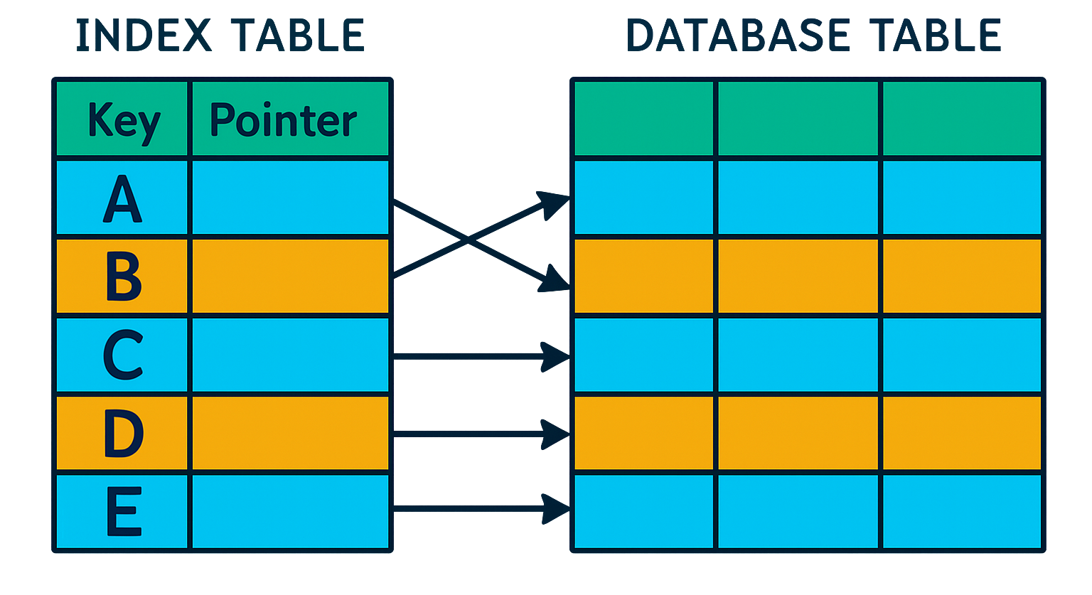
What are Database Indexes ?
Database Index guide the database to the exact location of the data, enabling faster and more efficient data retrieval.
A database index is a super-efficient lookup table that allows a database to find data much faster.
It holds the indexed column values along with pointers to the corresponding rows in the table.
Without an index, the database might have to scan every single row in a massive table to find what you want – a painfully slow process.
But, with an index, the database can zero in on the exact location of the desired data using the index’s pointers.

Slide 2

How do Database Indexes Work?
Here's a step-by-step explanation of how database indexes work:
Index Creation: The database administrator creates an index on a specific column or set of columns.
Index Building: The database management system builds the index by scanning the table and storing the values of the indexed column(s) along with a pointer to the corresponding data.
Query Execution: When a query is executed, the database engine checks if an index exists for the requested column(s).
Index Search: If an index exists, the database searches the index for the requested data, using the pointers to quickly locate the data.
Data Retrieval: The database retrieves the requested data, using the pointers from the index.

Slide 3

Benefits of Database Indexes
Database indexes offer several benefits, including:
Faster Query Performance: Indexes can significantly improve query performance especially for large datasets by reducing the amount of data that needs to be scanned.
Reduced CPU Usage: By reducing the number of rows that need to be scanned, indexes can decrease CPU usage and optimize resource utilization.
Rapid Data Retrieval: Indexes enable quick data retrieval for queries that involve equality or range conditions on the indexed columns.
Efficient Sorting: Indexes can also be used to efficiently sort data based on the indexed columns, eliminating the need for expensive sorting operations.
Better Data Organization: Indexes can help maintain data organization and structure, making it easier to manage and maintain the database.

Slide 4
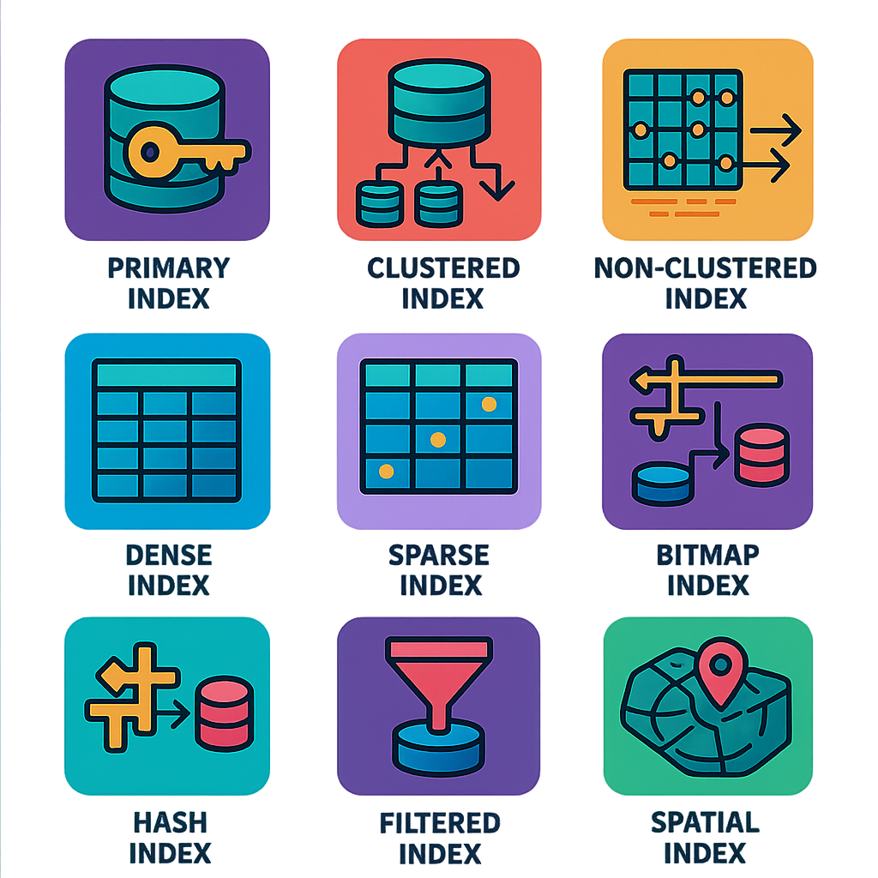
Types of Database Indexes
Indexes based on Structure and Key Attributes:
Primary Index
Clustered Index
Non-clustered or Secondary Index
Indexes based on Data Coverage
Dense index
Sparse index
Specialized Index Types
Bitmap Index
Hash Index
Filtered Index
Covering Index
Function-based index
Full-Text Index
Spatial Index

Slide 5
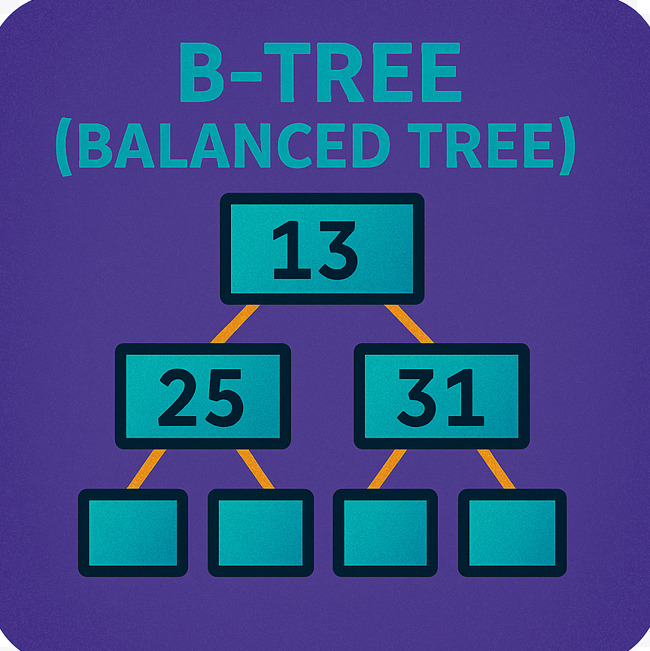
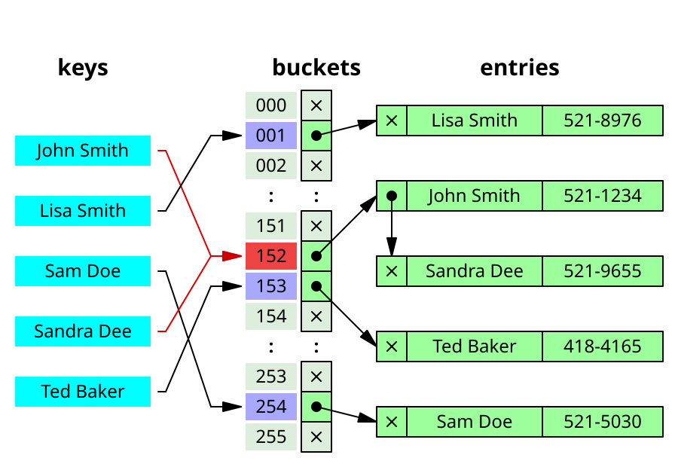

What Data Structure do Indexes use?
Most commonly used data structures that power indexes are B-Trees, Hash Tables and Bitmaps.
1. B-Tree (Balanced Tree)
Most database engines use either a B-Tree or a variation of B-Trees like B+ Trees.
B-Trees have a hierarchical structure with a root node, internal nodes (index nodes), and leaf nodes.
2. Hash Tables
Hash tables are used for hash indexes, which are based on a hash function.
A hash table consists of an array of buckets, with each bucket containing the addresses for rows in the data.
Hash indexes employ a hash function to map keys to their corresponding bucket in the hash table, enabling constant-time lookup operations.
3. Bitmaps
Each bit in the bitmap corresponds to a row, and the value of the bit indicates whether the key value exists in that row.
Bitmap indexes use a bitmap (a binary array) to represent the presence or absence of a specific key value in each row of a table.

Slide 6
How to use Database Indexes Smartly?
To get the most out of database indexes, consider these best practices:
Identify Query Patterns: Analyze the most frequent and critical queries executed against your database to determine which columns to index and which type of index to use.
Index Frequently Used Columns: Consider indexing columns that are frequently used in WHERE, JOIN, and ORDER BY clauses.
Index Selective Columns: Indexes are most effective on columns with a good spread of data values (high cardinality). Indexing a gender column might be less beneficial than one with a unique customer_id.
Use Appropriate Index Types: Choose the right index type for your data and queries.
Consider Composite Indexes: For queries involving multiple columns, consider creating composite indexes that encompass all relevant columns. This reduces the need for multiple single-column indexes and improves query performance.
Monitor Index Performance: Regularly monitor index performance, remove unused indexes and adjust your indexing strategy as the database workload evolves.
Avoid Over-Indexing: Avoid creating too many indexes, as this can lead to increased storage requirements and slower write performance.
Indexes take up extra disk space since they're additional data structures that need to be stored alongside your tables.
Every time you insert, update, or delete data in a table with an index, the index needs to update too. This can slightly slow down write operations.
To summarize, indexes are a powerful tool to optimize database query performance.
But remember to choose the right column and index type, monitor performance, and avoid over-indexing to get the most out of them.

